Slide 1
2.1–2.3 Variables, Data Types, Operators, and Expressions
ITP3914 – Programming
Part 2 – Concepts of Data Types and Operations

Slide 2

Part 1 – Variables

Slide 3
Variables
Variables are storage spaces for your program to hold data values.
Variables are being stored in the computer memory.
Variables must be declared (created):
Type of data to be stored inside
Name of the variables

Slide 4
An early taste on using variables
public class Circle {
public static void main(String [] args)
{
int radius;
double area;
radius = 3;
System.out.println("Radius = " + radius);
area = radius * radius * 3.14;
System.out.println("Area = " + area);
}
}
Data type
Name of the variable
radius
area
3
Assignment
radius
area
Expression
3
28.26
radius
area
You can also print the value stored in a variable.

Slide 5

Memory and Variables
Variables are stored in memory.
We use a variable’s name to refer to the variable so that we don’t bother to know where it is in the memory.
Reading the value stored in a variable does not change the value.
When a new value is placed into a variable, the old value is replaced.
public class Circle {
public static void main(String [] args)
{
int radius;
double area;
radius = 3;
area = radius * radius * 3.14;
radius=4;
area = radius * radius * 3.14;
}
}
radius
area
3
radius
area
3
28.26
radius
area
4
50.24
radius
area

Slide 6
Variables can be declared when you need it; not necessarily at the beginning of a block.
Obviously, variables must be declared before they are being used.
public class Circle {
public static void main(String [ ] args)
{
int radius;
radius = 3;
System.out.println("Radius = " + radius);
double area;
area = radius * radius * 3.14;
System.out.println("Area = " + area);
}
}

Slide 7
Declaring Multiple Variables
public class Box {
public static void main(String [ ] args)
{
int base, height, width;
…
}
}
You can declare multiple variables with the same data type in just one single statement. This is equivalent to:
int base;
int height;
int width;

Slide 8
Variable Initialization (1/2)
You can specify the value to be stored in the variable when it is being declared.
This program statement is equivalent to:
int radius;
radius = 3;
public class Circle {
public static void main(String [ ] args)
{
int radius=3;
System.out.println("Radius = " + radius);
double area;
area = radius * radius * 3.14;
System.out.println("Area = " + area);
}
}

Slide 9
Variable Initialization (2/2)
Be careful, no multiple initializations!
int n1, n2=28;
System.out.println(“n1 is “ + n1);
System.out.pritnln(“n2 is “ + n2);
If you compile the program,
c:\> javac MyTest.java
MyTest.java: variable n1 might not have been initialized
System.out.println(“n1 is “ + n1);
^
1 error
QUESTION:
How would you correct the program?

Slide 10
Identifiers Naming
An identifier is a name for a variable, method, or class.
Identifier naming rules:
consists of letters (a, b, …, A, B, …), digits (0, 1, 2, …, 9), underscore (_), and dollar sign ($).
does not begin with a digit
does not contain any spaces
cannot be a reserved word, such as public, class, int, double, …
are case-sensitive, thus, eat and Eat are two different identifiers

Slide 11
Java Reserved Words
abstract | continue | for | new | switch
assert | default | goto | package | synchronized
boolean | do | if | private | this
break | double | implements | protected | throw
byte | else | import | public | throws
case | enum | instanceof | return | transient
catch | extends | int | short | try
char | final | interface | static | void
class | finally | long | strictfp | volatile
const (not used) | float | native | super | while
NOTE: true , false, null are predefined values, thus cannot be used as identifiers.

Slide 12
Hey, you tell me…
consists of letters (a, b, …, A, B, …), digits (0, 1, 2, …, 9), underscore (_), and dollar sign ($).
does not begin with a digit
does not contain any spaces.
cannot be a reserved word, such as public, class, int, double, …
are case-sensitive, thus, eat and Eat are two different identifiers
3id | valid | invalid
o_no_o_no | valid | invalid
00_go | valid | invalid
start*it | valid | invalid
_yes | valid | invalid
1_i_am | valid | invalid
one_i_aren’t | valid | invalid
me_to-2 | valid | invalid
main | valid | invalid
xyShould | valid | invalid
$credit | valid | invalid
int | valid | invalid

Slide 13
Meaningful names please
Choose variable names that are meaningful, for example:
tax = price * taxRate;
Obviously, this statement is much better than
a = b * c;
Why?

Slide 14
Naming convention
“By convention” means that it is a habit and common practice among Java programmers.
By convention, class names begin with a Capital first letter and have a Capital letter for every word in the class name:
FullTimeStudent, SmartPhone
By convention, variable and method names begin with a lower-case first letter and have a capital first letter for every other word in the name:
totalAmount, studentName, findSum()
Don’t worry! We will explain what a method is later.

Slide 15
Constants
A constant is an identifier similar to a variable except that its value cannot be changed.
Use the keyword final to declare a constant.
final int MAX=100;
final double PI=3.14;
The statement below is invalid:
MAX = MAX*2;
By convention, constants have a name with all UPPER-CASE letters.

Slide 16
Part 2 – Data Types

Slide 17
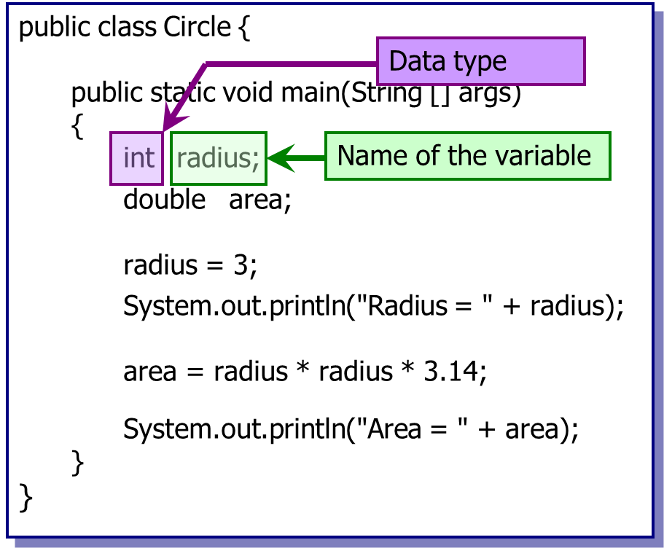
Remember, when declaring a variable, both variables names and data types are needed.
But…what data types are available in Java?

Slide 18
Primitive Data Types
Data Type
Size (bytes)
Range of Values
boolean
1
true, false
char
2
‘\u0000’ to ‘\uFFFF’ (0 to 65536)
byte
1
-2⁷ to +2⁷-1
-128 to +127
short
2
-2¹⁵ to +2¹⁵-1
-32768 to +32767
int
4
-2³¹ to +2³¹-1
-2147483648 to +2147483647
long
8
-2⁶³ to +2⁶³-1
-9223372036854775808 to
+9223372036854775807
float
4
-3.4028235x10³⁸ to +3.4028235x10³⁸
double
8
-1.79769313486231570x10³⁰⁸ to
+1.79769313486231570x10³⁰⁸

Slide 19
The Overflow Problem
public class TooLarge
{
public static void main(String [ ] args)
{
int a, b, ans;
a = 2000000000;
b = 2000000000;
ans = a + b;
System.out.println("a = " + a);
System.out.println("b = " + b);
System.out.println(“ans = " + ans);
}
}
c:\javaeg> java TooLarge
a = 2000000000
b = 2000000000
ans = -294967296
The answer is wrong!
Why?
How can the problem be solved?

Slide 20
The char Data Type
Example,
char ch = 'F';
char alpha = '\u03b1'; // the α
\u specifies a Unicode character.
03b1 is the Unicode value of the α character.
Chinese, Japanese, etc. etc. characters are all included in the Unicode specification.

Slide 21
Internal Representation of char
A computer can only store numerical values (binary numbers), but not English letters nor other symbols.
How does a computer store the letter ‘A’?
‘A’ is actually represented internally as the numerical value 65.
Similarly, each other character or symbol has its corresponding data value, e.g. ‘+’ is 43, ‘a’ is 97.
What are the integer representation of different characters?

Slide 22
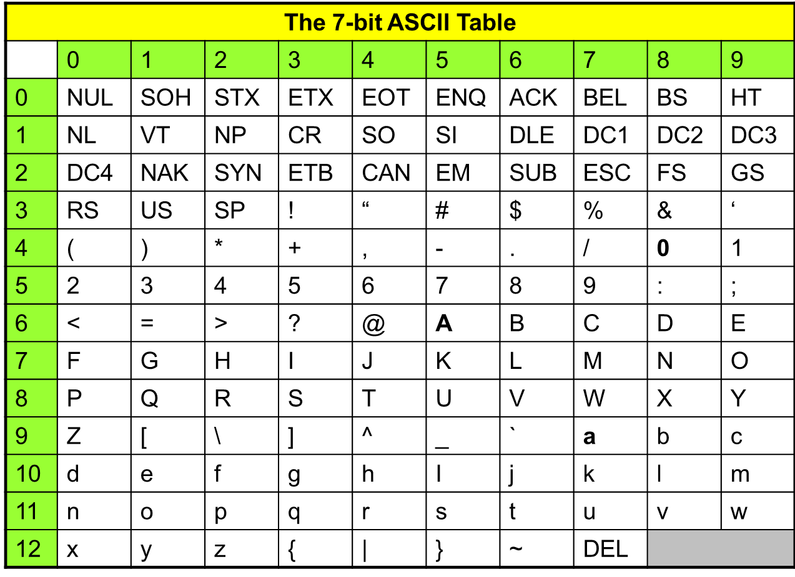
The first 128 characters are defined in the ASCII table.
Unicode adopts the ASCII table.
Other characters are further specified in Unicode.

Slide 23
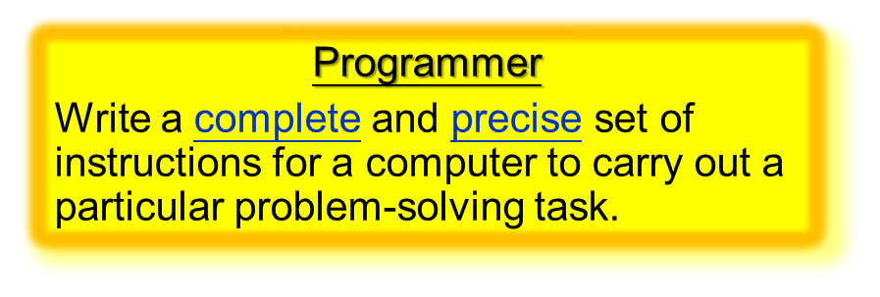
String Type
What is a String?
String is not a primitive data type.
String is a class.
We will let you know what a class is in Topic 4.
We will talk about String in detail later.
Example
String msg1 = "Welcome";
String msg2 = "Java" + "Programming";
String msg3 = "ITP" + 3914;
System.out.println(msg1);
System.out.println(msg2);
System.out.println(msg3);
" is used to enclose a String.
Oh! There is no space in between!!!!
Welcome
Welcome
JavaProgramming
Welcome
JavaProgramming
ITP3914

Slide 24
Question: What is the output of the program?
int x=46;
System.out.println("2000" + x);
System.out.println("Year=" + 2000 + x);
System.out.println("Year=" + (2000 + x));

Slide 25
Part 3 – Arithmetic Operators and Conversions

Slide 26
Arithmetic Operators
Operators | Operation | Example | Answer
+ | Addition | 12 + 4 | 16
- | Subtraction | 12 – 4 | 8
* | Multiplication | 12 * 4 | 48
/ | Division | 12 / 4 | 3
% | Modulus division | 12 / 5 | 2
Unlike many other programming languages, Java does not provide operator for exponentiation.
Instead, it must called using a method. For example, 4³
System.out.println( Math.pow(4, 3) );

Slide 27
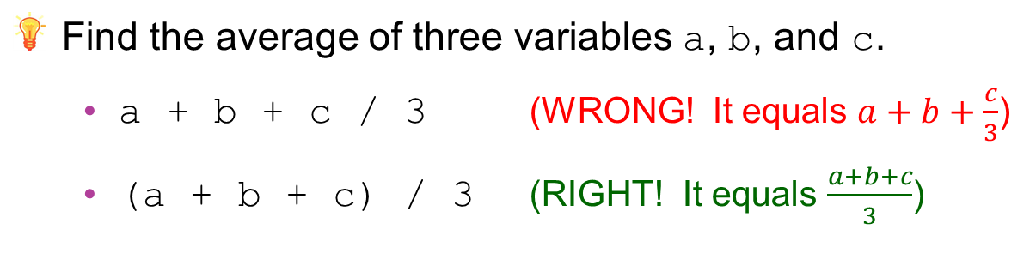
Arithmetic Precedence
Some arithmetic operators act before others.
Precedence | Operator
1 | ( )
2 | * / %
3 | + -
Find the average of three variables a, b, and c.
a + b + c / 3 (WRONG! It equals $a+b+\frac{c}{3}$)
(a + b + c) / 3 (RIGHT! It equals $\frac{a+b+c}{3}$)

Slide 28
Arithmetic Conversions
An arithmetic expression has a value and a data type.
int x = 5;
System.out.println( x*3–6 );
The expression x*3–6 has the value 9 of type int.
In the example above, all operands are int and thus there is no problem.
When an expression contains operands of different data types, unification is needed, so that the entire expression after evaluation has a particular data type.

Slide 29
Arithmetic conversions are performed by Java automatically.
Expression Result
3 / 2 1 (not 1.5 !!!)
Same data type in expression; no conversion needed.
3.0 / 2.0 1.5
3 / 2.0 1.5
3.0 / 2 1.5
Data types not unified. Arithmetic conversions needed.
Expression Promotion Result
3 / 2.0 3.0 / 2.0 1.5
mixed double / double double
Promotion rule: When two different types are involved in an expression, the smaller type (fewer bits) is promoted to the larger type before the expression is evaluated.

Slide 30
Casting
Casting is specified by a Java programmer explicitly.
Casting converts a type to another explicitly.
The target data type is put in parentheses () in front of the value being converted.
int i;
float f=9.6f;
i = (int) f; // i now stores 9, no roundup
Be careful:
The value 9.6 is retrieved from f and converted to integer 9. The value stored inside f remains unchanged, i.e., 9.6.

Slide 31

Casting and char
Recall that char values are actually stored as integer values internally.
int ans = (int) ('A' + 1.8);
'A' has a numerical value 65.
65 is converted to 65.0
('A'+1.8) becomes (65.0 + 1.8), i.e. 66.8
66.8 is casted to integer 66
So, ans stores 66.

Slide 32
Casting and Integer Division
Expression After casting Auto Conversion Result
Integer Division
3 / 2 1
(double) 3 / 2 3.0 / 2 3.0 / 2.0 1.5
WORKS!!!
3 / (double) 2 3 / 2.0 3.0 / 2.0 1.5
(double) (10 / 3) (double) 3 3.0
WRONG!!!

Slide 33
Shorthand Assignment Operators
Any statement of form
variable = variable operator expression;
can be written as
variable operator= expression;
k *= 5;
k = k * 5;

Slide 34
int c=6, d=5, e=3, f=9, g=12;
Operator | Example | Equivalent | Results
+= | c += 7 | c = c + 7 | c stores 13
-= | d -= 4 | d = d – 4 | d stores 1
*= | e *= 5 | e = e * 5 | e stores 15
/= | f /= 3 | f = f / 3 | f stores 3
%= | g %= 9 | g = g % 9 | g stores 3
Be careful! An implicit ( ) is here!
r *= 2 + 3* 4;
r = r * ( 2 + 3*4 ); // r = r * 14;

Slide 35
The Pre-Increment ++Operator
++k increases the value of variable k by 1.
public static void main(String [] args)
{
int k=5;
++k;
}
k stores 6.
If ++k occurs in an expression, k is incremented before its value is used in the expression.
public static void main(String [] args)
{
int j, k=5;
j = ++k;
}
Interpretation: k=k+1; j=k;
k becomes 6.
j receives 6.

Slide 36
The Post-Increment Operator++
k++ increases the value of variable k by 1.
public static void main(String [] args)
{
int k=5;
k++;
}
k stores 6.
If k++ occurs in an expression, k is incremented after its value is used in the expression.
public static void main(String [] args)
{
int j, k=5;
j = k++;
}
Interpretation: j=k; k=k+1;
j receives 5.
k becomes 6.

Slide 37
The Decrement Operator --
--k and k-- behave in a similar way as the increment operators (k++ and ++k),
but decreasing the value of the variable by one.
public static void main(String [] args)
{
int j, k=5;
j = --k;
}
Interpretation: k=k-1; j=k;
k becomes 4.
j receives 4.
public static void main(String [] args)
{
int j, k=5;
j = k--;
}
Interpretation: j=k; k=k-1;
j receives 5.
k becomes 4.

Slide 38
++ -- Examples
Operator | Example | Equivalence
pre-increment ++a | int a=5, b; b = ++a + 10; | int a=5, b; a = a + 1; b = a + 10;
post-increment a++ | int a=5, b; b = a++ + 10; | int a=5, b; b = a + 10; a = a + 1;
pre-decrement --a | int a=5, b; b = --a + 10; | int a=5, b; a = a – 1; b = a + 10;
post-decrement a- | int a=5, b; b = a-- + 10; | int a=5, b; b = a + 10; a = a – 1;

Slide 39
Operator Precedence again
Operator | Associativity
() ++ (postfix) -- (postfix) | Left to right
+ (unary) - (unary) ++ (prefix) -- (prefix) | Right to left
* / % | Left to right
+ - | Left to right
= += -= *= /= etc. | Right to left

Slide 40
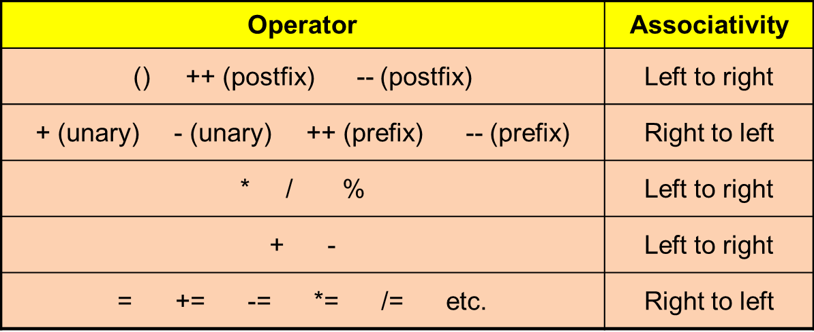
Operator Precedence examples
Evaluate the expression below:
int h=1;
int k;
k = 3 + 5 * (4+3) - ++h;
k = 3 + 5 * (4+3) - ++h;
k = 3 + 5 * 7 - ++h;
k = 3 + 5 * 7 - ++h;
k = 3 + 5 * 7 - 2;
k = 3 + 5 * 7 - 2;
k = 3 + 35 - 2;
k = 3 + 35 - 2;
k = 38 - 2;
k = 38 - 2;
k = 36;

Slide 41
END

